Slide 1
Electronic Devices Introduction
ED Lect. 1
V Kumar
Email:vkumar52@iitism.ac.in
Tel.: Office: 5426
Mobile: 9431122030

Slide 2
ourse Type | Course Code | Name of Course | L | T | P | Credit
DC | ECC201 | Electronic Devices | 3 | 1 | 0 | 11
Course Objective
The objective of the course is to develop an understanding of the device concepts and their operation that will be needed in a broad range of areas including modern semiconductor devices, circuit and VLSI design and engineering.
Learning Outcomes
Upon successful completion of this course, students will: acquire a basic knowledge of the physical characteristics, such as electronic structures and optical and transport properties of semiconductors develop the understanding of the physics and internal working of the basic solid state devices and derive their characteristics have appreciation of semiconductor technology and advanced devices
Unit No. | Topics to be Covered | Lecture Hours | Learning Outcome
1 | Physics and Properties of Semiconductors: Band structure, Fermi distribution, Density of states, intrinsic and extrinsic semiconductors, carrier concentration at thermal equilibrium | 7 | Acquire an understanding of the semiconductor band structure and calculation of carrier concentrations
2 | Carrier transport phenomena: Carrier drift and diffusion, Generation and recombination, Minority carrier lifetime, Continuity equation, Solution of diffusion equations, Quasi Fermi levels, Hall effect | 7 | Develop an understanding about the carrier transport in semiconductors
3 | p-n junctions: Built-in potential, Depletion region, Electrostatics of p-n junction, Derivation of diode equations, Current voltage characteristics, Capacitance, Transient behavior, Junction breakdown, Metal semiconductor junctions, Ohmic contact, Schottky diode, Solar Cells, Photodiodes, LEDs and Laser Diodes | 8 | Understand the functioning of various pn junction and metal semiconductor junction devices and derive their characteristics
4 | Bipolar junction transistors: Transistor analysis, Frequency response and switching, Ebers-Moll model, small signal model (h equivalent), Deviations from the ideal behavior | 8 | Ability to derive the BJT characteristics and obtain their mathematical models
5 | MOS system, Electrostatics of MOS structure, Capacitance Voltage characteristics, MOSFET fundamentals, I-V characteristics and MOS models | 7 | Understand the fundamentals and characteristics of MOS devices
6 | State-of-the-Art MOS Technology: small-geometry effects, fin-FETs, ultrathin body FETs, ballistic transport, hot-electron effects. | 3 | Get an overview of MOS technology and recent developments of device features

Slide 3
Recommended books
Textbook:
Solid State Electronic Devices, B. G. Streetman and S. K Banerjee, Pearson Education India (2015)
Reference Books:
2. Semiconductor Device Fundamentals, R, F, Pierret, Pearson (2006)
3. Integrated Electronics, J. Millman and C. Halkias,and C. Parikh, Tata
McGraw-Hill, 3RG ed., (2017)
4. Principle of Electronic Materials and Devices, S. O. Kasap, McGraw Hills, 3rd Ed (2006)
5. Semiconductor Physics and Devices, D. Neamen and D. Biswas, McGraw Hill Education (2017)
6. Semiconductor Devices, Physics and Technology, S. M. Sze and M. Lee, John Wiley & Sons (2015)
7. Fundamentals of Modern VLSI Devices, Y. Taur and T. H. Ning, Cambridge University Press (2016)
Weightage distribution of a course may now be done accordingly.
The suggested distribution is:
Mid Sem: 0
End Sem: 48 Remaining 52% marks includes 4 mandatory quizzes (40% to 52%) and assignment(s) if any(12% to 0%)

Slide 4
Topics of Unit 1:
Topic:
Physics and Properties of Semiconductors:
Band structure,
Fermi distribution,
Density of states,
Intrinsic and extrinsic semiconductors,
Carrier concentration at thermal equilibrium

Slide 5
Introduction: Physics and Properties of Semiconductors
Why we study Electronics? What is electronics?
Science: is an art of knowing the fact of the nature/ universe.
It is the study of the physical world and natural laws.
It is the study to discover the origin of life.
Physics: is the science that deals with matter & energy, and their interactions.
: the physical processes and phenomena of a particular system.
Electronics : Electronics is science (technology) of controlling energy by
movement of electrons. There will be moment (mv) loss.
Photonics: is science of controlling energy by movement of photons. Photons (Energy E = hᵞ) are mass-less and hence no momentum (mv) loss.
Optoelectronics: is science of controlling photon energy by movement of photons.
Instrumentation: is process of controlling various energy levels
and control energy exchanges.

Slide 6
Electronic Devices: Provides students with a sound understanding of
existing devices.
It is a power tool to learn newly developed devices too.
Semiconductor (S/C) Device: is an electronic component that exploit the electronic props. of S/Cs (Si, Ga, GaAs, Alloys AlGaAS;
Organic S/Cs, and
graphene metal S/Cs= next generation technology)
to make as single desecrate device or an IC.
Properties of S/C conductivity (σ) can be controlled by an e .f., m.f., heat or doping

Slide 7
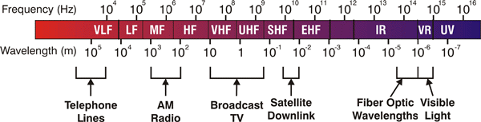
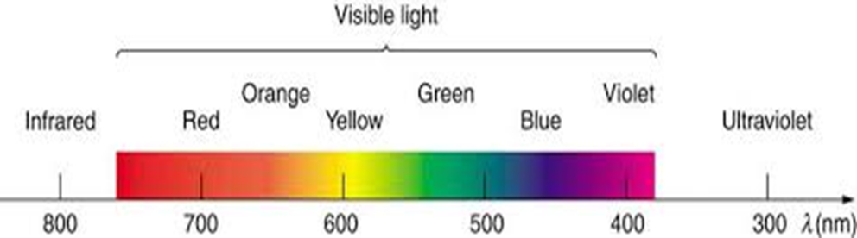
Electromagnetic Spectrum:
kHz³ MHz⁶ GHz⁹ THz¹² OF¹⁴⁻¹⁵
X-ray 10¹⁸ | y-ray 10²¹ | Cosmic ray 10²¹

Slide 8
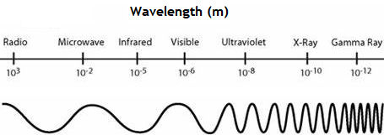
Type of Radiation | Frequency Range (Hz) | Wavelength Range
gamma-rays | 10²⁰ - 10²⁴ | < 10⁻¹² m
x-rays | 10¹⁷ - 10²⁰ | 1 nm - 1 pm
ultraviolet | 10¹⁵ - 10¹⁷ | 400 nm - 1 nm
visible | 4 - 7.5*10¹⁴ | 750 nm - 400 nm
near-infrared | 1*10¹⁴ - 4*10¹⁴ | 2.5 μm - 750 nm (Optical F)
infrared | 10¹³ - 10¹⁴ | 25 μm - 2.5 μm
microwaves | 3*10¹¹ - 10¹³ | 1 mm - 25 μm
radio waves | < 3*10¹¹ | > 1 mm

Slide 9
Semiconductor : A S/C (Semi +conductor) is defined as a material whose conductivity lies between a conductor and insulator. Conductivity(σ) , Resistivity (ρ) of some materials are shown below: (σ = 1/ ρ)
 | Insulators | Semicon-ductors | Conductors | Organic S/Cs | Graphene metal S/Cs
σ (S/cm) | 10⁻¹⁸ – 10⁻⁸ | 10⁻⁸ - 10⁴ | 10⁴ - 10⁶
ρ (Ω-cm) | 10¹⁸ - 10⁸ | 10⁸ – 10⁻⁴ | 10⁻⁴ – 10⁻⁶
Periodic Table: relevant part
Period | II | III | IV | V | VI
2 |  | B | C | N | O
3 | Mg | Al | Si¹⁴ | P | S
4 | Zn | Ga | Ge³² | As | Se
5 | Cd | In | Sn | Sb | Te
6 | Hg |  | Pb

Slide 10
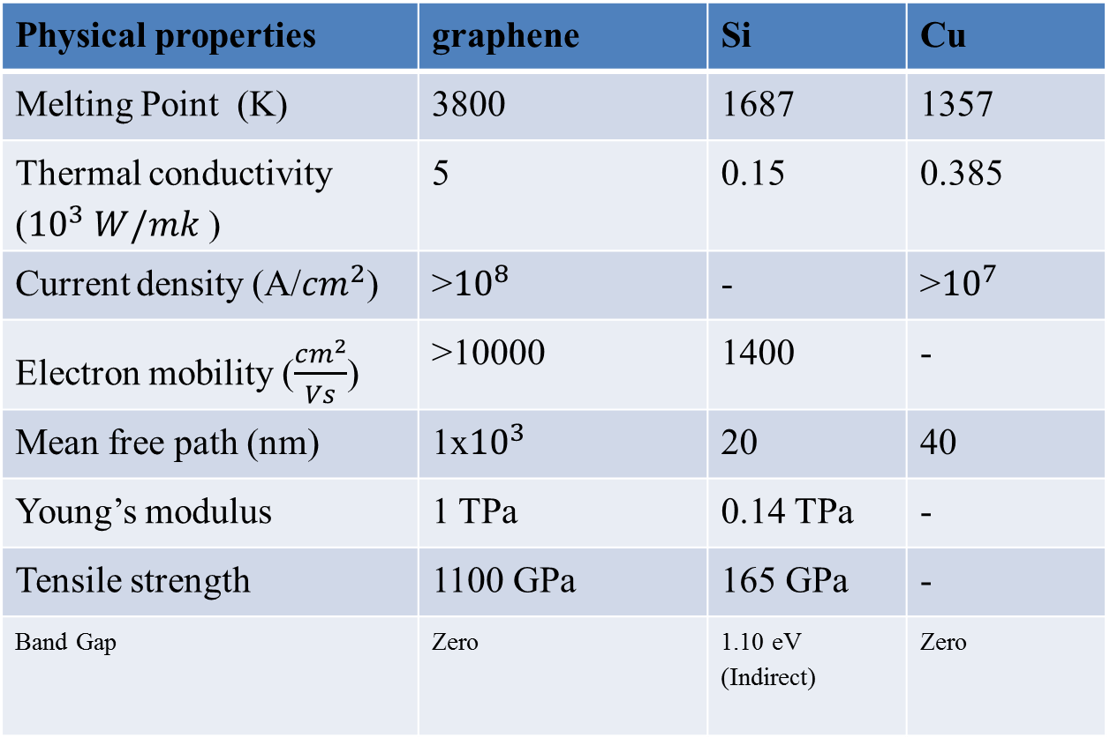
Comparison of Physical properties of Graphene, Silicon (Si) and Copper (Cu)
Physical properties | graphene | Si | Cu
Melting Point (K) | 3800 | 1687 | 1357
Thermal conductivity (${10}^{3} W/mk$ ) | 5 | 0.15 | 0.385
Current density (A/${cm}^{2}$) | >${10}^{8}$ | - | >${10}^{7}$
Electron mobility ($\frac{{cm}^{2}}{Vs}$) | >10000 | 1400 | -
Mean free path (nm) | 1x${10}^{3}$ | 20 | 40
Young’s modulus | 1 TPa | 0.14 TPa | -
Tensile strength | 1100 GPa | 165 GPa | -
Band Gap | Zero | 1.10 eV (Indirect) | Zero

Slide 11
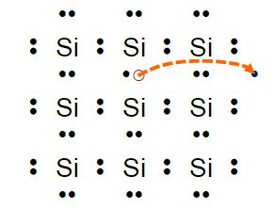
Conduction Electrons in Pure (Si) Semiconductor
Si and Ge are 4th gp materials having 3-dimensional, diamond type, tetrahedral S/C (4 nos of valence electrons in the outermost orbit). The crystals are covalently bonded with the neighbouring atoms. Thy are weak-bond and broken due to thermal excitation and electron becomes free and function as charge carrier to conduction through crystal.

Slide 12
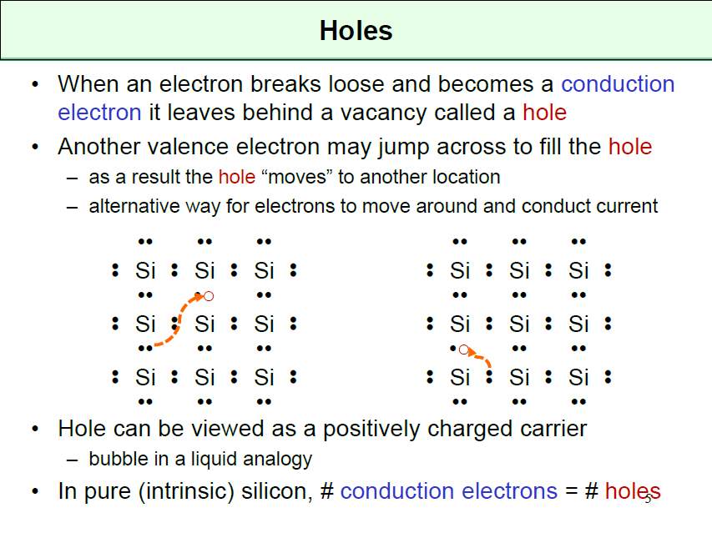
Some of these Figures are from Brian Ackland, Stevens Institute of Technology, NJ

Slide 13
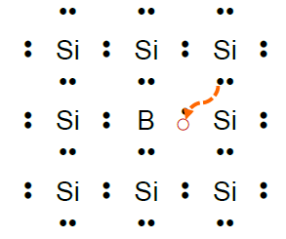
Impure S/Cs or Doped S/Cs:
If we introduce a boron (group III-acceptor) atom:
B B⁻ + hole
in neighboring atom
Can accept an extra electron which creates a hole –leads to a negative B─ ion
– but no conduction electron
– property of semiconductors: large changes in conductivity through the
addition of trace amounts of dopant material

Slide 14
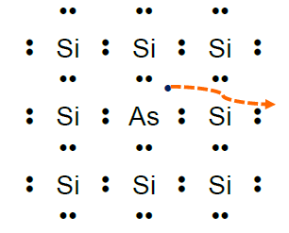
Replace one silicon atom with an arsenic (group V - donor) atom:
As As⁺ + electron
majority
Contributes one extra electron which is weakly held
– free to wander at room temperature (almost 100% ionization)
– electron leaves behind a positive As+ ion – but no hole

Slide 15
ED Lect 2. (Ref. -Saleh & Teich)
Types of S/Cs and their Applications
Elementary, Binary, Ternary, and quaternary S/Cs
Ref. -Saleh & Teich

Slide 19
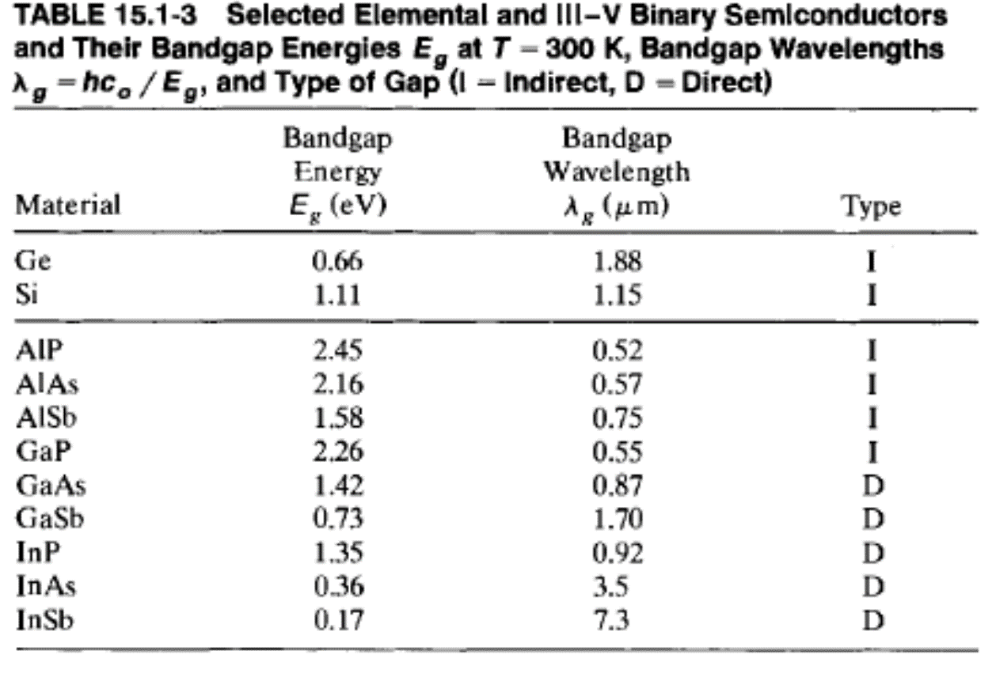

Slide 20
Elemental S/Cs: Si, Ge
E_{g} = 1.11 0.66
λ_{g} = 1.15 1.88
Binary S/Cs:
III-V binary S/Cs
AlP AlAs AlSb
E_{g} (eV) = 2.45 2.16 1.58
λ_{c} (μm) = hᵞ/E_{g} (eV ) = 0.52 0.57(VIS) 0.75
GaP GaAs GaSb
E_{g} (eV) = 2.26 1.42 0.73
λ_{c} (μm) =1.24/E_{g} = 0.55 0.87 (NIR) 1.70
GaAs is the best S/C for the LED of Ist window of the O.F.
InP InAs InSb

Slide 21
Solid curve – D Gap
Dashed curve- I Gap

Slide 22
II-V binary S/Cs
II-VI | ZnO
 | ZnS | CdS | HgS
 | ZnSe | CdSe | HgSe
 | ZnTe | CdTe | HgTe

Slide 23
Ternary S/Cs: :
(Al_{x}Ga_{1-x})As |  | E_{g} (eV) | λ_{g} (μm) | a (Aº )
x=0 | GaAs | 1.42 | 0.87 | 5.64
x=1↑ | AlAs | 2.16 | 0.57 λ↓ Blue Shift | 5.55
(Ga_{x}Al_{1-x})As
x=o | AlAs | 2.16 | 0.57 | 5.55
x=1 ↑ | GaAs | 2.42 | 0.87 λ↑ Red shift | 5.64
In_{x} Ga_{1-x} AS
x=o | GaAs | 2.42 | 0.87 | 5.64
x=1↑ | InAs | 0.36 | 3.44 λ Red Shift

Slide 24
Quarternary S/Cs
(In_{1-x} Ga_{x})(As_{1-y}P_{y} ):
Appls. :1.2 to 1.6 µm W/L LED

Slide 25
(In_{1-x} Ga_{x})(As_{1-y}P_{y} )
 |  | E_{g} (eV) | λ_{g} (μm)
X=0=y | InAs | 0.36 | 3.44
X=1=Y | GaP | 2.26 | 0.55
Mixing ratio of x and y is y= 2.16 (1-x)
USED BETWEEN 1.1 - 1.6 µm W/L LEDs & PDs

Slide 26
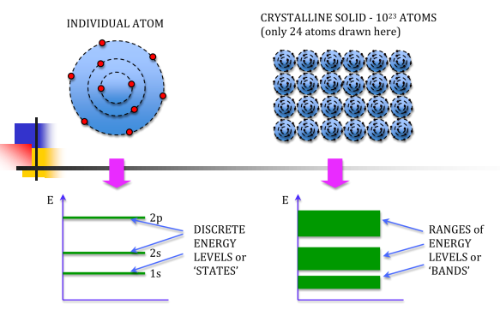
ED Lect 3: (Strretman + Kasap) .
Energy Band in Solids
What is meant by energy bands in solids?
An isolated atom possesses discrete energies of different electrons. ...
If 'N' number of atoms are brought together to form a solid (Ex: bricks/ stone pieces form wall, roof, road) and if these atoms' electrons interact and give 'N' number of closely spaced energy levels in the place of discrete energy levels, it is known as bands of allowed energies

Slide 27
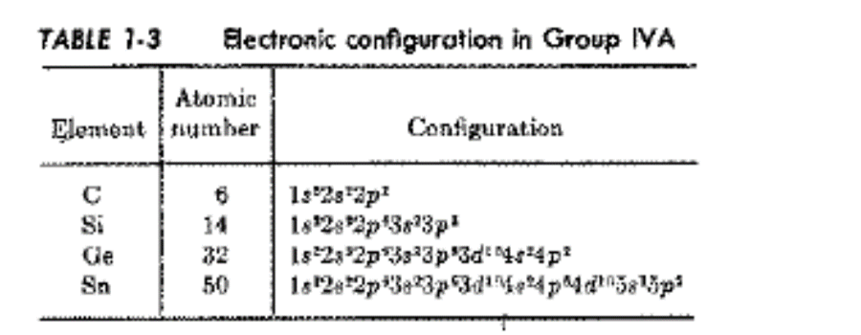
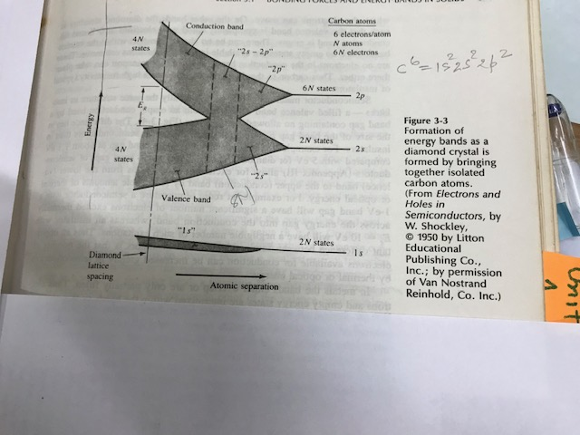
Ex.- C⁶ = 1S² 2sp²

Slide 28
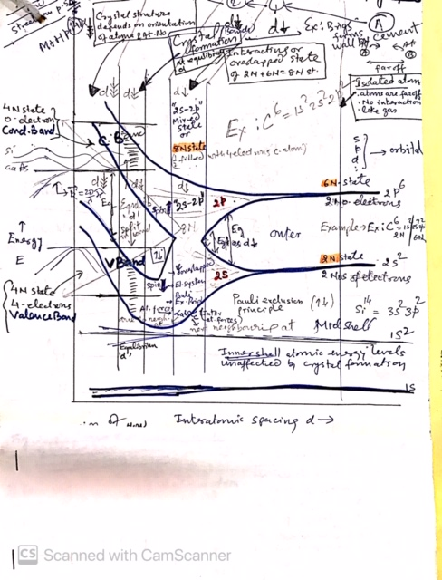

Slide 29
Ex. -Si¹⁴ = 3S² 3p²: As the distance b/w atoms approaches the equilibrium inter atomic distance of Si, i.e. d=a, the band splits in two bands separated by energy gap
CV
Empty
VB

Slide 31
xxxxxxx

Slide 32
LCAOs form Molecular orbitals

Slide 33
Electronic Stru

Slide 34
LCAO of 2 atoms

Slide 35
LCAO of 2H atoms⁵

Slide 36
LCAO of 3H atoms⁵

Slide 37
Each

Slide 38
Ex. of N Li³ (=1s² 2s¹) atoms
As the distance b/w atoms approaches the equilibrium inter atomic distance of Si, i.e. d=a, the band splits in two bands separated by energy gap E_{g}
free

Slide 42
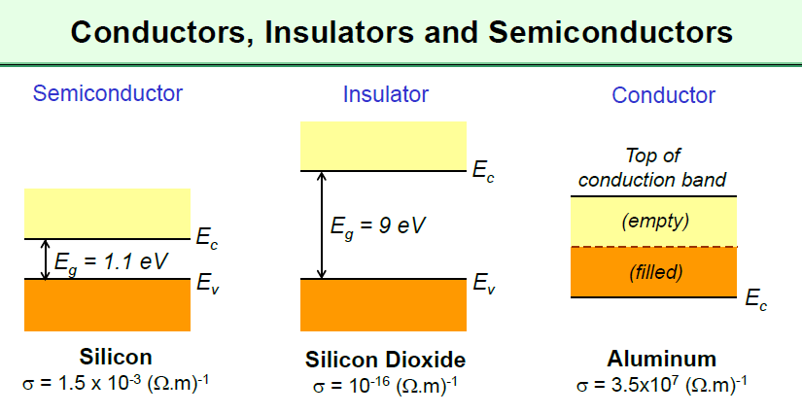
Lect 4
Totally filled and totally empty bands do not allow current flow
Metal conduction band is half-filled
Semiconductors: Conductance dramatically increased through impurity doping

Slide 43
Direct and Indirect Band gap¹
Ex: DG- GaAs, GaSb, InAs, InP; Ex: IG- Si, Ge, AlP, AlS

Slide 46
(Al_{x}Ga_{1-x})As |  | E_{g} (eV) | λ_{g} (μm) | a (Aº )
x=0 | GaAs | 1.42 | 0.87 | 5.64
x=1↑ | AlAs | 2.16 | 0.57 λ↓ Blue Shift | 5.55

Slide 47
Up to X= 38% follow direct gap

Slide 48
3.2.2 Effective Mass¹
Mass of moving electron is known as effective mass. It is different than the rest mass or mass of electron.

Slide 49
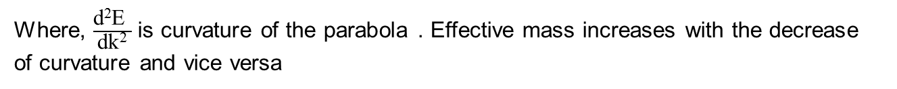
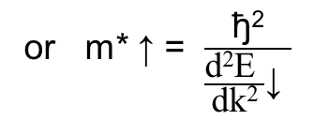
Find the (E, k) relationship for free electron and relate it to the electron mass¹
From de Broglie relation, a moving electron in
a crystal with a wavelength λ, electron momentum p
is given by De Broglie relation as:
p = h/λ = h/(2π/k) = ђk
Also p = mv ,i.e., v= p/m
= ak² Parabola
or m* ↑ = $\frac{\text{ђ}\text{2}}{\frac{\text{d}\text{2}\text{E} }{\text{dk}\text{2}}\text{↓} }$
Where, $\frac{\text{d}\text{2}\text{E} }{\text{dk}\text{2}}$ is curvature of the parabola . Effective mass increases with the decrease of curvature and vice versa

Slide 50
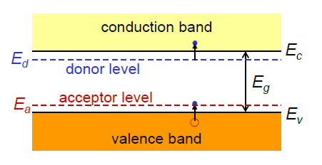
P- type and N-type Semiconductors
N-type silicon has a donor energy level
- Donor ionization energy = Ec – Ed ≈ 50 meV
P-type silicon has an acceptor energy level

Slide 51
Totally filled and totally empty bands do not allow current flow
Metal conduction band is half-filled
Semiconductors: Conductance dramatically increased through impurity doping

Slide 53
Lect 5. Carrier Concentration^{1,5}
Electrons in solids obey Fermi-Dirac statistics. However, classical particles (e.g.) obey Boltzmann statistics (atomic transition)

Slide 54
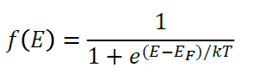
The Fermi Energy¹
Electrons in solids obey Fermi-Dirac statistics. However, classical particles (e.g.) obey Boltzmann statistics (atomic transition)
Fermi-energy is defined as energy of the top most filled level a absolute zero, i.e., T=0.
Fermi Dirac distribution function f(E) gives the probability that an available energy state at E occupied by an electron at absolute T.
Or
It tells the distribution of electrons over a range of allowed energy levels at
thermal equilibrium and given by the following relation:
where E is the energy state occupied by an electron at abs. Temp T,
k is the Boltzmann constant k = 8.62 x 10 ⁻⁵ eV/K = 1.38 x 10 ⁻²³ J/K, and E_{F} is called Fermi level and is an important quantity in the analysis of S/C behavior.

Slide 55
1. At T=0 and
2. At T>0

Slide 56
In the band theory, we have seen that when the distance b/w atoms approaches the equilibrium inter atomic distance of Si, i.e. d=a, the band splits in two bands separated by energy gap / forbidden energy gap

Slide 57
Expo. decay

Slide 58
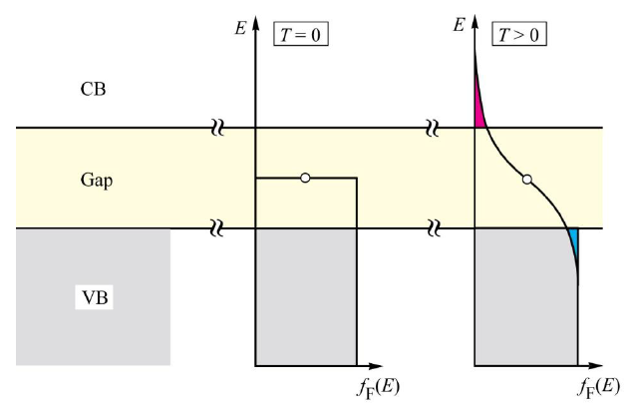
Intrinsic semiconductor

Slide 59
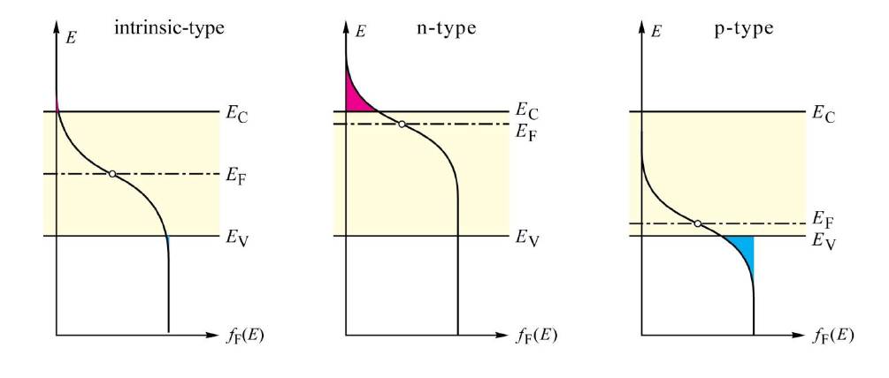
Fermi function for intrinsic and doped s/c
ef_psd

Slide 60
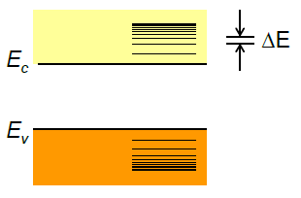
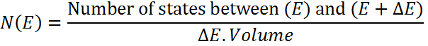
Density of States

Slide 61
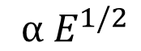
Lect 6: Carrier concentration at thermal equilibrium (n₀)
Since Fermi Dirac Distribution Function f(E) gives the probability that an available energy state at E occupied by an electron at absolute T. This helps us in calculating the electron and hole concs. in a S/C if densities of available states (DOSs) are known. We can write
$${ α E}^{1/2}$$

Slide 62
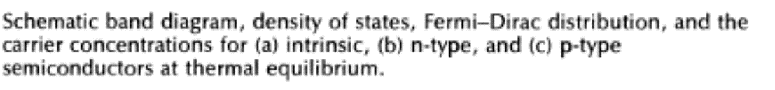
Electrons
(a) Intrinsic
Holes
(b) n-type
(c) p-type
dos N(E)
f(E)
Carrier concs

Slide 70
Some useful forms
N_{c}: Effective density of state at bottom of C.B.
N_{v}: Effective density of state at top of V.B.

Slide 71
Values of N_{c} and N_{v} for Si, Ge and GaAs at 300 K.
 | Si | Ge | GaAs
m_{n} (x m₀) | 1.08 | 0.89 | 0.067
m_{p} (x m₀) | 0.55 | 0.29 | 0.47
N_{c} (cm⁻³) | 2.82 x10¹⁹ | 2.10 x10¹⁹ | 4.32 x10¹⁷
N_{v} (cm⁻³) | 1.02 x10¹⁹ | 3.91 x10¹⁸ | 8.07 x10¹⁸
Do not take these numbers very seriously

Slide 72
Lect 7. Fermi Level of Intrinsic Semiconductor

Slide 73
Intrinsic Carrier Concentration
n*p is independent of E_{F}
Law of mass action
n_{i} for Si is approximately 10¹⁰ cm⁻³

Slide 74
Fermi Energy for Extrinsic Semiconductors
Assume shallow donors → Complete ionization
⇒ n = N_{D}
Similarly, for holes

Slide 75
Example
Si is doped with As 10¹⁶ cm⁻³.
Find carrier concentration and Fermi level at 300 K.
Assume n_{i} = 10¹⁰ cm⁻³ ; N_{c} =10²⁰ cm⁻³
n=10¹⁶ cm⁻³ ; p = 10⁴ cm⁻³
E_{c} – E_{F} = 0.23 eV

Slide 76
Compensated Semiconductors
Both donor and acceptor impurities are present
Impurity with higher concentration determines the type of
conductivity
Fermi level must adjust to preserve charge neutrality
Using
Similarly

Slide 77
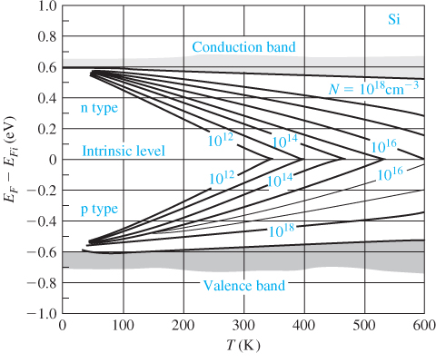
Effect of Temperature on E_{F}

Slide 78
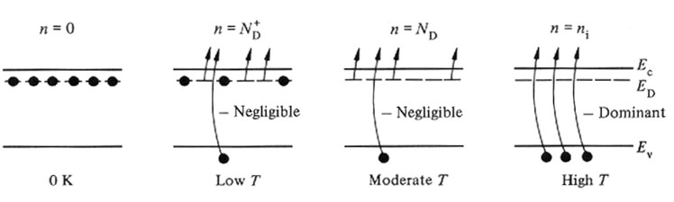
Carrier ionization: effect of temperature
Freeze-out region
Not all donor impurities ionized
Some electrons are frozen
Extrinisc region
All donor impurities ionized
Intrinsic region
Electrons excited from VB
Intrinsic carrier conc. Becomes
comparable to the donors

Slide 79
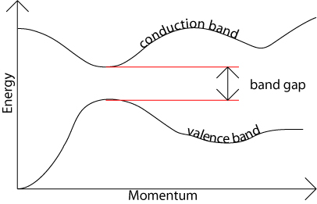
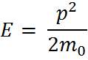
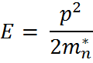
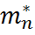
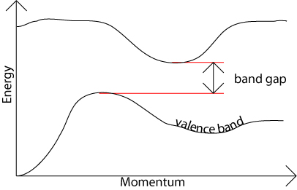
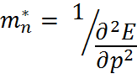
Energy Momentum diagrams & Effective mass
Free Electrons:
Inside a s/c crystal:
: Electron effective mass
Similarly, for holes

Slide 80
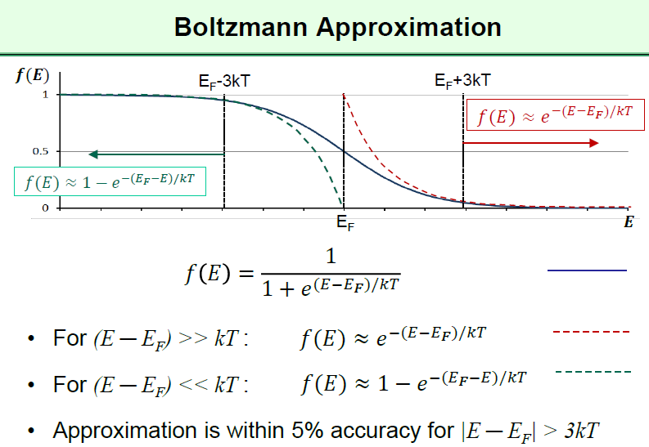
For (E_{F} – E) >> kT

Slide 81
Basic block of S/C devices
Metal-semiconductor interface;
p-n junction;
Heterojunction interface;
Metal-oxide-semiconductor structure.
Ack.: Ekapon, KMUTT

